Slide 1
TIRESIAS: Predicting Security Events Through
Deep Learning
Group Name: Aw, Snap!
Group Members: Weijia Sun, Xinyu Lyu, Mengmei Ye

Slide 2

contents
4. Experiments results
1. Problem
5. Related Work
2. Motivation
6. Future Work
3. Approach

Slide 3

Part 1
Problems

Slide 4


Problems
Attack techniques-> unprecedented sophistication.
Detecting malicious activity when happens is not enough.
Need to predict following specific steps taken by adversary.
Tiresias : A security system, which can predict the security event sequence based on the previous observations and Deep Learning Models.
Notes:
Nowadays, the attack techniques to computer systems have reached an unprecedented sophistication.
Therefore, only detecting malicious activity when it happens is not enough for defenders.
There is a need to predict the specific steps which will be taken by adversary when performing an attack.

Slide 5
Part 2
Motivations

Slide 6
Motivations
Previous research: Focused on predicting whether malicious events will happen or not, based on the binary outcome.
An arm race:
Attackers may change their modus operandi from time to time.
Therefore, there is a need to improve the methods against the attackers.
Unbalanced Data:
It is hard to collect enough data with all kinds of labels to train the module.
(especially some rare events)
Notes:
whether a data breach would happen whether hosts will get infected . no insight information on the following modus operandi which will be made by attackers.

Slide 7
Part 3
Challenges & Approach

Slide 8

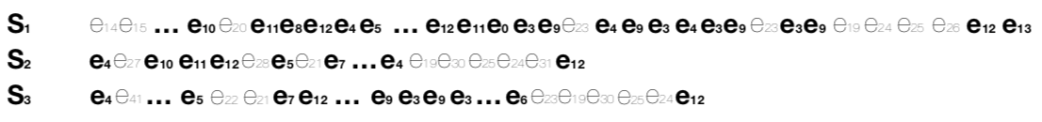
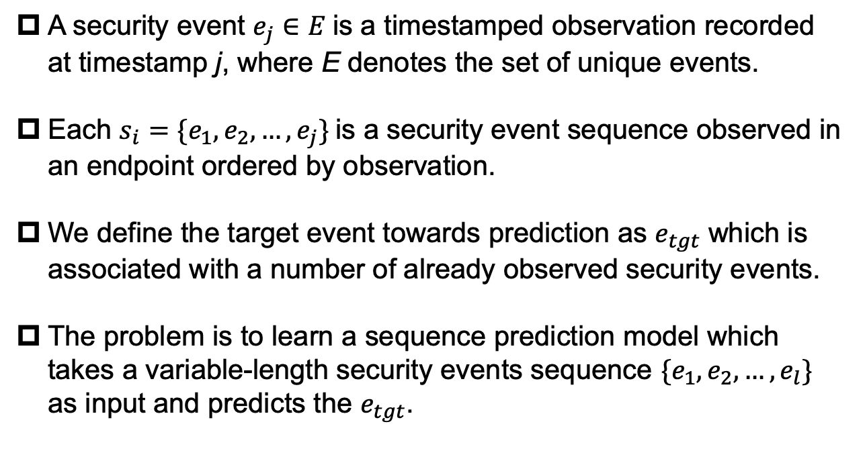
Problem Formulation
A security event $e_{j}∈E$ is a timestamped observation recorded at timestamp j, where E denotes the set of unique events.
Each $s_{i}=\{e_{1},e_{2},…,e_{j}\}$ is a security event sequence observed in an endpoint ordered by observation.
We define the target event towards prediction as $e_{tgt}$ which is associated with a number of already observed security events.
The problem is to learn a sequence prediction model which takes a variable-length security events sequence $\{e_{1},e_{2},…,e_{l}\}$ as input and predicts the $e_{tgt}$.

Slide 9
Challenges
Hard to find a visible security event pattern ->
Hard to find a particular event will follow or precede another event among the events sequence.
Difficult to predict each step of the multi-step attack.
Bad effect from irrelated events->
The security events sequence will get mixed with irrelated events (noisy events).
Noisy events will prevent the system from making the correct forecast.
Multi-attacks from different adversaries->
There will be multi-attacks from different adversary groups happening at the same time.
Different security Event sequence get mixed and hard to distinguish the events from multi-attacks.

Slide 10
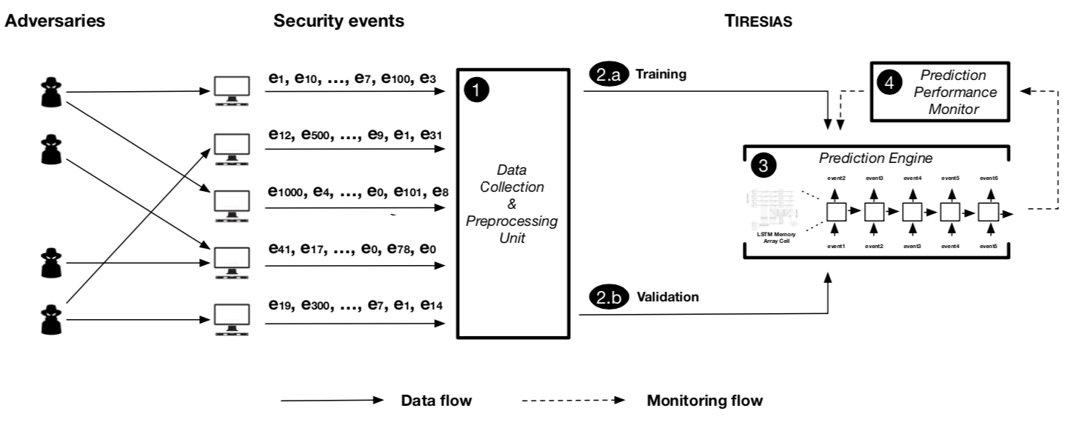
Approach
Tiresias
Data collection: Collecting previous security events sequence.
Training & Validation : Training Rocki-LSTM to predict future events based on previous observations. Validation to choose best model.
Prediction Engine: LSTM predicts security event sequence based on previous observations.
Performance Monitor: Monitor a sharp drop on precision, retrain the module will get automatically.
Notes:
Feasible
millions of machines from Symantec’s intrusion prevention product
3.4 billion security events

Slide 11

Approach-Module Selection(RNN)
Input: Take $s=\{x_{1},x_{2},…,x_{l}\}$ as sequential input.
Train: Recurrently update the hidden layer $h_{t}$ based on each current input $x_{t}$ and on the previous hidden layer $h_{t−1}$.
Prediction: Based on the previous hidden layer $h_{t−1}$ and current input $x_{t}$ to predict current output $y_{t}$.
Disadvantage: Shot-term memory reliable.
Notes:
Can’t keep long-term memory
Can’t be deep
Gradient vanish of backpropagation(tanh activation function)

Slide 12

Approach-Module Selection(LSTM)
Forget : Use forget gate $Z^{f}(0,1)$ to selectively
forget the unimportant previous memory $c^{t−1},$
from previous cell state.
Remember: Use input gate $Z^{i}(0,1)$ to selectively
remember the important input $Z$.
Output: Use output gate $Z^{o}(0,1)$ to determine
which outputs will be treated as the current states
output.
Transfer: Transfer $c^{t}$ and $h^{t}$ to next state.
Advantage: Process a longer input sequence than
RNN without short-term memory reliable problem.
LSTM(Long short-term memory)
Notes:
Alternative method

Slide 13
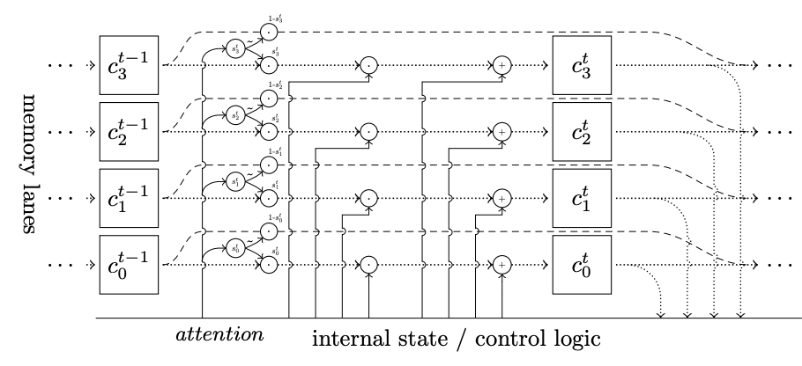
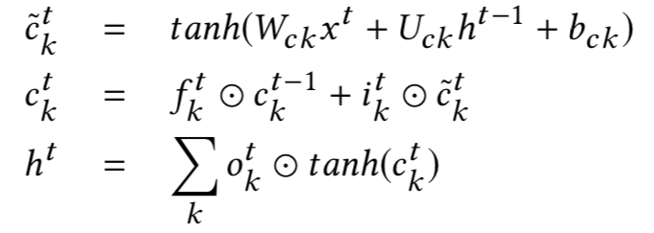
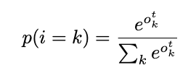
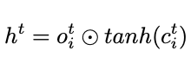
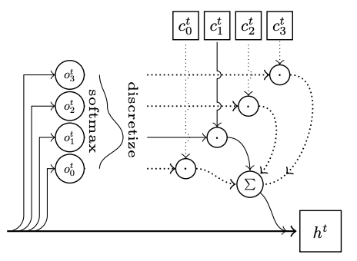
Approach-Module Selection(Rocki-LSTM)
Rocki-LSTM
A single layer RNN:
Training session computational efficiently.
More complex memory structures (array-like structure):
k controls the number of cell memory vectors.
Stochastic design:
More resilient on noisy sequential input data.
Notes:
Modified version of LSTM
As a Make up for the simple network.
Parallelly make multi-output prediction
Mostly likely output, cell state based -> update the hidden layer.
Multi-class classification train task->no details

Slide 14

Approach-Data Collection & Preprocessing
TIRESIAS reconstruct the data collected from millions of machines from Symantec’s intrusion prevention product to D.
$D=\{s_{1},s_{2},…,s_{m}\}$, where m denotes the number of machines.
$s_{i}=\{e_{1},e_{2},…,e_{l}\}$, denotes a sequence of security events ordered by timestamps l.
Then, they split the data into $D_{T}$ (training data) and $D_{V}$ (validation data), where $D_{T} ∩D_{V}= ∅$.
Separate $D_{T}$ to $D_{1}$and $D_{2}$:
D1 data contains 27 days of data composed of over 2.2 billion security events.
Nov 1st- Nov 7th is used to train the model.
Nov 8th- Nov 17th is used to evaluate the module performance.
Nov 1st- Nov 5th is used to choose the best model and compared to the baseline models.
D2 data contains the 8th and 23rd day of each month between Nov 2017-Feb 2018 composed of 1.2 billion security events to evaluate if the module retains stability after a long time.
From each event, they extract anonymized machine ID, timestamp, security event ID, event description, system actions and other information as features.
.

Slide 15
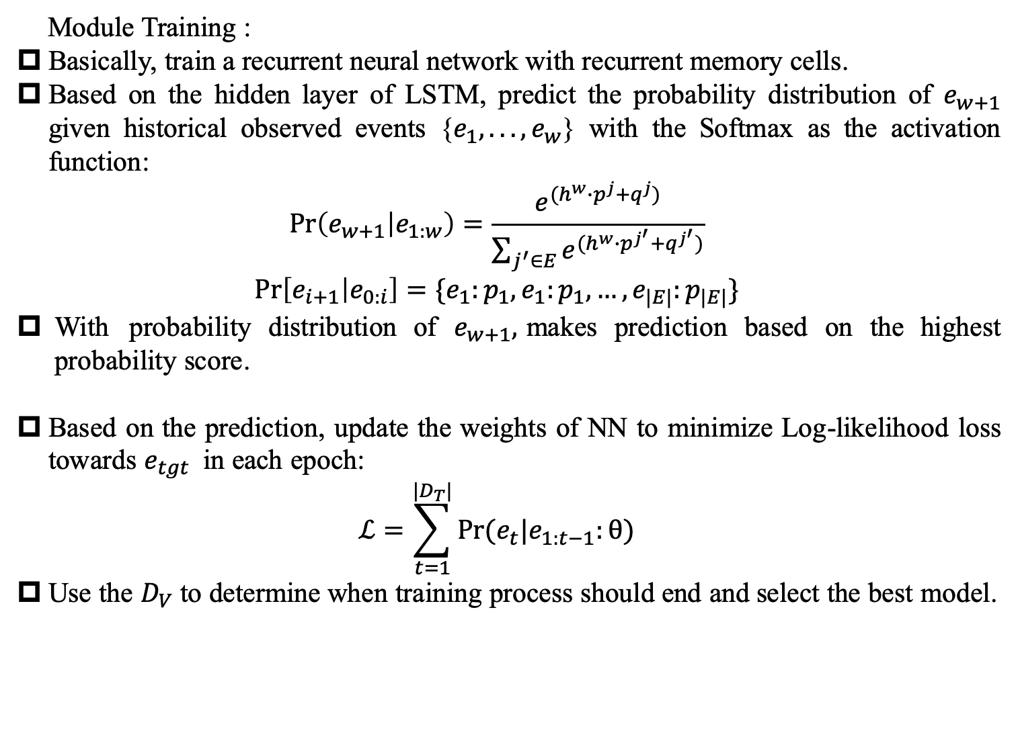
Approach-Module training and validation
Module Training :
Basically, train a recurrent neural network with recurrent memory cells.
Based on the hidden layer of LSTM, predict the probability distribution of $e_{w+1}$ given historical observed events {$e_{1},...,e_{w}$} with the Softmax as the activation function:
$$\operatorname{Pr}\left(e_{w+1} | e_{1:w}\right)=\frac{e^{(h^{w}∙p^{j}+q^{j})}}{\sum_{j^{′}∈E}{e^{(h^{w}∙p^{j^{′}}+q^{j^{′}})}}}$$
$$\operatorname{Pr}\left[e_{i+1} | e_{0:i}\right]=\{e_{1}:p_{1},e_{1}:p_{1},…,e_{|E|}:p_{|E|}\}$$
With probability distribution of $e_{w+1},$makes prediction based on the highest probability score.
Based on the prediction, update the weights of NN to minimize Log-likelihood loss towards $e_{tgt}$ in each epoch:
$$ℒ=\sum_{t=1}^{|D_{T}|}{Pr⁡(e_{t}|e_{1:t−1}:θ)}$$
Use the $D_{V}$ to determine when training process should end and select the best model.
Notes:
not in details
a common multi-class classification task

Slide 16
Approach-Module evaluation
Precision
F1-score
Recall
They made model performance evaluation based on some metrics such as Precision, Recall, F1 score. Moreover, if the precision drops quickly, they will retrain the module.

Slide 17
Part 4
Experiments & results

Slide 18
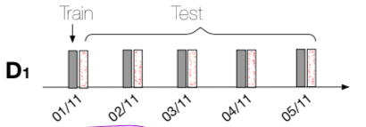
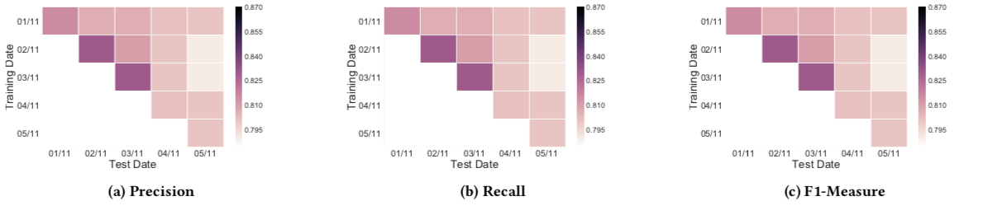
Experiments & results
Overall Experiments and results:
Experiment:
From D1, they train model using on day of data and evaluate
the model using the same day and the followings days until
5 Nov 2017.
Results:
Precision over 80% precision.
Precision and Recall are well balanced with a similar scale (from 0.87 to 0.795).
Sudden decrease 6.9% retrained.

Slide 19
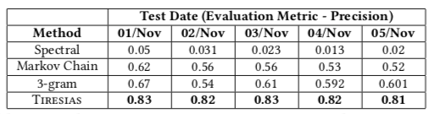
Experiments & results
Comparison study:
Experiment:
The comparison study uses daily data(1 Nov – 5 Nov) from D1.
Training, validation and test data are all from the same day of different machines.
Results:
Tiresias can easily beat the performance of baselines such as Spectral, Markov Chain and
3-gram(has values higher than 0.8).

Slide 20
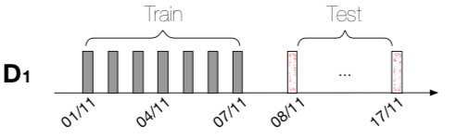
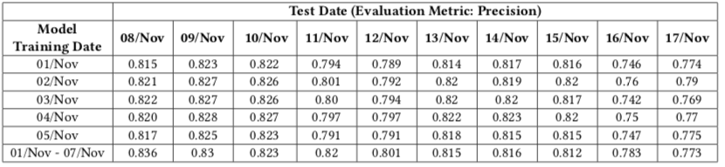
Experiments & results
Influence of training period length:
Experiment:
Training:
1. From D1, train five models using the one-day data from 01 Nov to 05 Nov.
2. From D1, train one single model with the one-week data from 01 Nov to 07.
(In contrast to prove a longer training period can offer better performance)
Evaluation: Evaluate on the test data from 8 Nov to 17 Nov.
Results:
1. Precision:
One week data training (0.82), One day data training (0.79).
2. Efficient : The same.
3. Deviating :
Week long train more stable compared with one day.
Notes:
Model will benefit from long-term training or short-term training

Slide 21
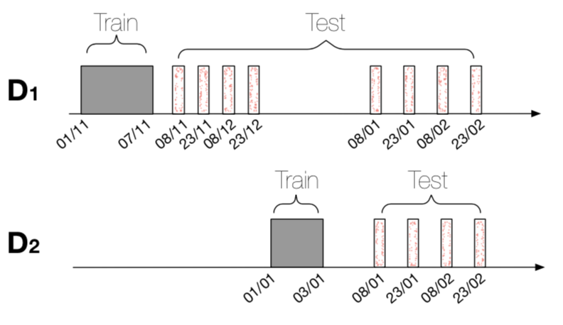
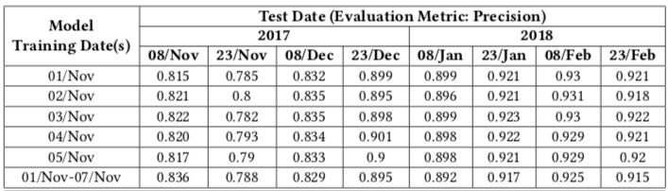
Experiments & results
Stability Over Time:
Experiment:
Training : Train the model using daily data(1 Nov – 7 Nov) from D1.
Testing : Evaluate the model using (1 Nov 2017 – 23 Feb 2018 )
from D2.
Results:
Stable performance:
1. Standard deviation ten days 0.02.
2. The model quickly converges towards high accuracy with only
one or a few days of training data.
3. The model ages very well even after it was built.

Slide 22
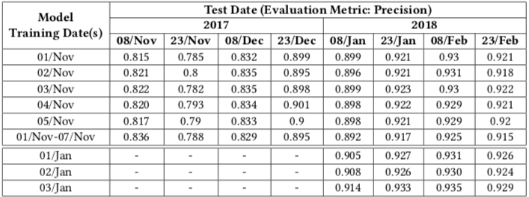
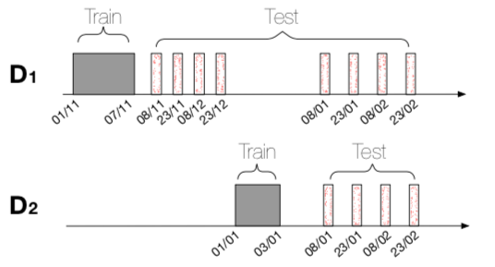
Experiments & results
Guess:
Because of some reason, the presence of the top three recorded alarms decreased by an
order of magnitude, having 4th to 10th position.
(The most probable reason is the installations of patches.)
Experiments:
Training: Train the model with the first days of Jan 2018.
Evaluation: Evaluate the model with the January and February dates.
Results:
The model performs slightly better than the one trained in Nov 2017.
Therefore, it indicates that the Tiresias remain reliable even moths after the system was trained.
Notes:
a new vulnerability starts being exploited in the wild, an existing system patch fixes

Slide 23
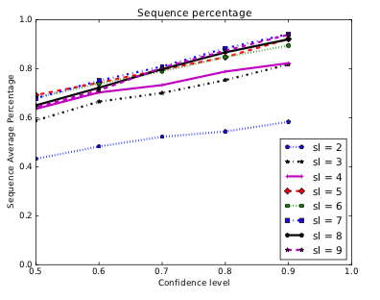
Experiments & results
Sequence Length Evaluation:
Experiment:
Whether long-term memory or short-term memory is more influential in making decision.
Short-term: system relies on a few elements of the sequence to make its decision to predict.
(The ones closest to the element that the system is trying to guess.)
Long-term: uses the whole sequence or a large part of it to make its decision to predict.
Results:
Short-term: The sequence less than 5 show that the system’s
prediction is not very confident.
Long-term: The sequence more than 5 are more unique and
often correctly predict the last event.
Therefore, Tiresias rely more on long-term memory than
short-term memory.

Slide 24
Part 5
Related Work

Slide 25
Related Work
1. System-level security event forecast:
Soska trained the ensemble C4.5 classifiers to predict if a given website will become malicious in the future, based on the features from website.
Bilge design the RiskTeller leverages both supervised and semi-supervised methods to predict if the machine is at risk, based on the binary log information of machines.
2. Organization-level security event forecast:
Liu trained a Random Forest classifier to forecast security incidents, based on features including 258 features covering two main categories : mismanagement symptoms and malicious activities.
Liu furtherly prove the malicious activities are stable indicators to build the predictable model. He train a SVM model based on intensity, duration and frequency.
3. Cyber-level security event forecast:
Sabottke build a Twitter-based exploit detector to predict the vulnerabilities disclosed in Microsoft products.
4. Binary Analysis:
Shin build RNN models to identify if the 256-vector one-hot encoding functions will happen or not, based on a binary classification output.
4. Anomaly Detection:
Du proposed the DeepLog using LSTM to learn the system’s log patterns. And help identify abnormal log entries.
5. Malware Classification:
Pascanu model malware API calls as a sequence and use RNN to predict the next API calls.

Slide 26
Part 6
Future Work

Slide 27


Future Work
Attention based LSTM to replace Rocki-LSTM.
Make a comparison between ml/dl methods and Rocki-LSTM about training time efficiency, model performance ...
Show more statistical analysis on standard deviation between Long/short term data to prove that long-term data training is more robust to anomalies.
Notes:
Only lstm outdated
Doubt about the conclusions.
Contradictory opposite

Slide 28
Group Name: Aw, Snap!
Group Members: Weijia Sun, Xinyu Lyu, Mengmei Ye

